Slide 1
Marketing Lecture # 14 Muhammad asad Instructor department of computer science

Slide 2
Key Learning Point :-
- Discussion about strategic management process

Slide 3
STRATEGIC MANAGEMENT
Facing intense pressure from users over privacy issues, Facebook CEO Mark Zuckerberg exposed a new set of controls to help people better understand what information they are sharing online.
Charles Schwab, chairman and founder of his namesake financial services company, is worried about his customers, especially since his company’s success depends on his financial adviser’s ability to keep those customers “engaged” in equities markets.

Slide 4
Vente-privee.com, one of Europe’s top E-Tailors, is looking to expand in Europe, but not in the United States, where competition from outlet malls and discounters is too great.
The private equity firm, C. Dean Metropoulos & Company, has reached an agreement to buy Pabst Blue Ribbon, a once-popular beer brand, with hopes of rebuilding its share in a competitive market.
These are just a few of the business news stories from a single week, and each one is about a company’s strategies.

Slide 5
WHAT IS STRATEGIC MANAGEMENT?
Walmart and Kmart Corporation have battled for market dominance since 1962, the year both companies were founded --- Other similarities, store atmosphere, names, markets served, and organizational purpose.
Yet, Walmart’s performance (financial and non-financial) batter than Kmart --- Walmart is the world’s largest retailer and Kmart was the largest retailer.
Why the difference in performance?
Because of different strategies and competitive abilities --- Walmart has shined by using strategic management effectively while Kmart has struggled by failing to use strategic management effectively.

Slide 6
Strategic management is --- what managers do to develop the organization’s strategies --- It’s an important task involving all the basic management functions planning, organizing, leading, and controlling.
What are an organization’s strategies?
They’re the plans for how the organization will do whatever it’s in business to do, how it will compete successfully, and how it will attract and satisfy its customers in order to achieve its goals.

Slide 7
One term often used in strategic management is business model, which simply is how a company is going to make money. It focuses on two things…
1: Whether the customers will value what the company is providing.
2: Whether the company can make any money doing that.
FOR EXAMPLE
Dell founded a new business model for selling computers to consumers directly online instead of selling through computer retailers like other manufacturers --- Did customers “value” that? Absolutely! --- Did Dell make money doing it that way? Absolutely!
As managers think about strategies --- that about the economic feasibility / possibility of their company’s business model.

Slide 8
WHY IS STRATEGIC MANAGEMENT SO IMPORTANT?
In 2000, Star Plus telecast a TV serial “Saas Bhi Kabhi Bahu Thi” --- That are most popular serial until November 2008 (ended) --- a large number of viewers adjusted in every evening to watch the story unfold.
The first mythological serial “Ramayan” was telecast during the period (1987-1988) --- It became quickly popular and got a place in the Limca Book of Records.
The producers of the IPL (T-20) understand the importance of strategic management because they are developing and exploiting every aspect of the cricket match --- talk shows, cheer leaders, brand managers, merchandize and etc.

Slide 9
There are three reasons strategic management important…
First, it can make a difference in how well an organization performs --- Why do some businesses succeed and others fail, even when faced with the same environmental conditions? (Remember our Walmart and Kmart example)
Management Research has found a generally positive relationship between strategic planning and performance. In other words, it appears that organizations that use strategic management do have higher levels of performance.

Slide 10
Second, reason managers in the organizations (either Profit or Non-Profit and Big or Small in size) face continually changing situations --- They cope with this uncertainty by using the strategic management process --- to observe relevant factors and decide what actions to take.
Third, reason strategic management is important because organizations are complex and diverse --- Each part needs to work together toward achieving the organization’s goals.
For example, Walmart with more than 2.1 million employees worldwide working in various departments, functional areas, and stores --- Walmart Stores Inc. uses strategic management to help coordinate --- and --- focus employee’s efforts on what’s important as determined by its goals.

Slide 11
Today, both business organizations and not-for-profit organizations use strategic management.
For example, the U.S. Postal Service (USPS) is locked in competitive battles with overnight package delivery companies, telecommunications companies e-mail and text messaging services and private mailing facilities.
In 2006, 213 billion pieces of mail were handled by the postal service. In 2009, 177 billion pieces of mail were handled a decline of almost 17 percent. John Potter, (USPS) CEO is using strategic management to come up with a response.

Slide 12
However, some strategic changes are needed as the USPS faces losses of $238 billion over the next decade. Strategic management will continue to be important to its operation. Check out the USPS Vision 2013, which outlines its internal plan for the future.
Although strategic management in not-for-profits hasn’t been as well researched as it has in for-profit organizations, we know it’s important for these organizations as well --- But why?

Slide 13
THE STRATEGIC MANAGEMENT PROCESS
The strategic management process contain six-step process that includes strategy planning, implementation, and evaluation --- The best strategies can fail if management doesn’t implement or evaluate them properly.
STEP 1: Identifying the Organization’s Current Mission, Goals, and Strategies
STEP 2: Doing an External Analysis
STEP 3: Doing an Internal Analysis
STEP 4: Formulating Strategies
STEP 5: Implementing Strategies
STEP 6: Evaluating Results

Slide 14
STEP 1: IDENTIFYING THE ORGANIZATION’S CURRENT MISSION, GOALS, AND STRATEGIES
Every organization needs a mission ---- a statement of its purpose.
Defining the mission --- force managers to identify --- what it’s in business to do...
1: The mission of Facebook is “a social utility that connects you with the people around you”.
2: The mission of the National Heart Foundation of Australia is to “reduce suffering and death from heart, stroke, and blood vessel disease in Australia”.
These statements provide clues to what these organizations see as their purpose. What should a mission statement include?

Slide 15
COMPONENTS OF A MISSION STATEMENT
CUSTOMERS: Who are the firm’s customers?
MARKETS: Where does the firm compete geographically?
CONCERN FOR SURVIVAL, GROWTH, AND PROFITABILITY: Is the firm committed to growth and financial stability?
PHILOSOPHY: What are the firm’s basic beliefs, values, and ethical priorities?
CONCERN FOR PUBLIC IMAGE: How responsive is the firm to societal and environmental concerns?
PRODUCTS OR SERVICES: What are the firm’s major products or services?
TECHNOLOGY: Is the firm technologically current?
SELF-CONCEPT: What are the firm’s major competitive advantage and core competencies? Concern for employees: Are employees a valuable asset of the firm?

Slide 16
STEP 2: DOING AN EXTERNAL ANALYSIS
STEP 3: DOING AN INTERNAL ANALYSIS
STEP 4: FORMULATING STRATEGIES

Slide 17
To perform these steps manager conduct SWOT analysis…
S - TRENGTHS Any activities the organization does well or any unique resources that it has.
W - WEAKNESSES Any activities the organization doesn’t do well or resources it needs but doesn’t possess.
O - OPPORTUNITIES Positive trends in the external environment.
T - THREATS Negative trends in the external environment.
Strengths and Weaknesses are internal factors can be controlled.
Opportunities and Threats are external factors uncontrolled.

Slide 18
SWOT ANALYSIS
In 1960, A management consultant from Standford Research Institute, Albert Humphrey and his team invented a framework to help businesses with more sustainable strategic planning --- The framework initially was introduced as SOFT Analysis (Satisfactory, opportunity, fault and threat).
The idea is simple, the strengths and weaknesses of an organization are matched with the threats and opportunities of the environment to formulate an effective strategy --- Capitalize opportunities by using its strengths and avoid the threats by reducing weaknesses.

Slide 19
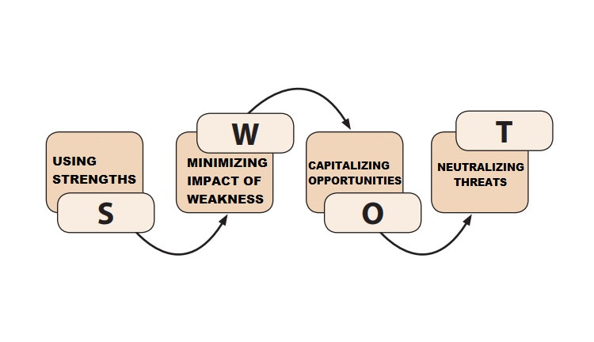

Slide 20

STRENGTHS (internal factor can be controlled)
Strengths are the aspects of an organization that make it better than its competitors --- Such as, the strength of a company can be having one of the best technological tools and human resource in the market --- Can help the company use it to improve its business.

Slide 21
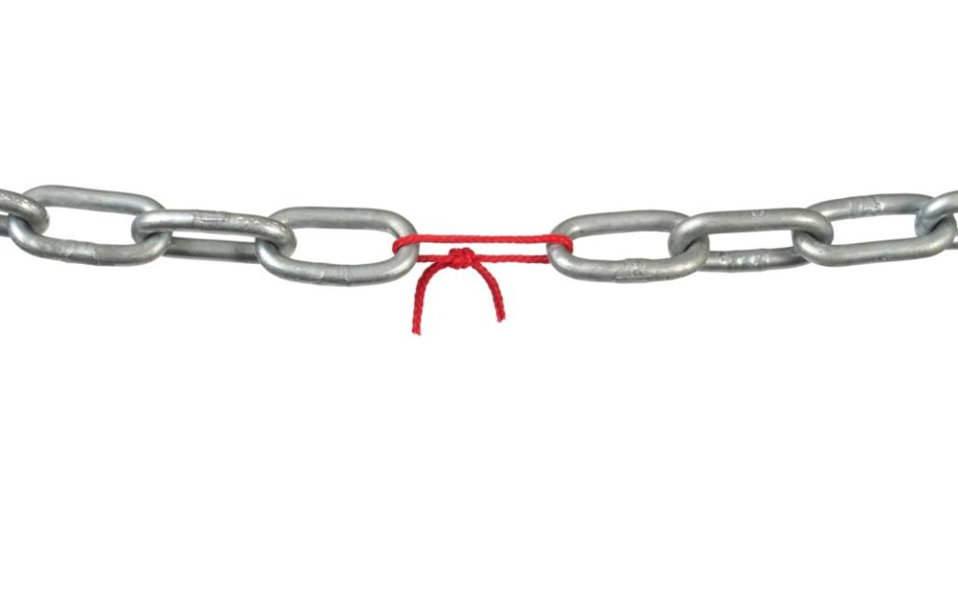
WEAKNESSES (internal factor can be controlled)
Weaknesses are certain drawbacks that distance you from your strength --- Areas where the organization needs to improve to remain competitive in the market --- Such as, high debts, lack of financial & human resources, inadequate supply chain, etc. --- Need to upgrade or Improve to avoid the threats.

Slide 22

OPPORTUNITIES (External factor --- Uncontrolled)
Opportunities means detailed study of the external environment (Specific & General) --- It encourages the entrepreneur to look at all external factors that can bring in profitability to the business and new areas of improvement --- Identifying opportunities on time is very important to plan future activities effectively.
Such as, if a country changes its
import laws, then a car exporter
can increase his sales by taking
advantage of this opportunity.

Slide 23
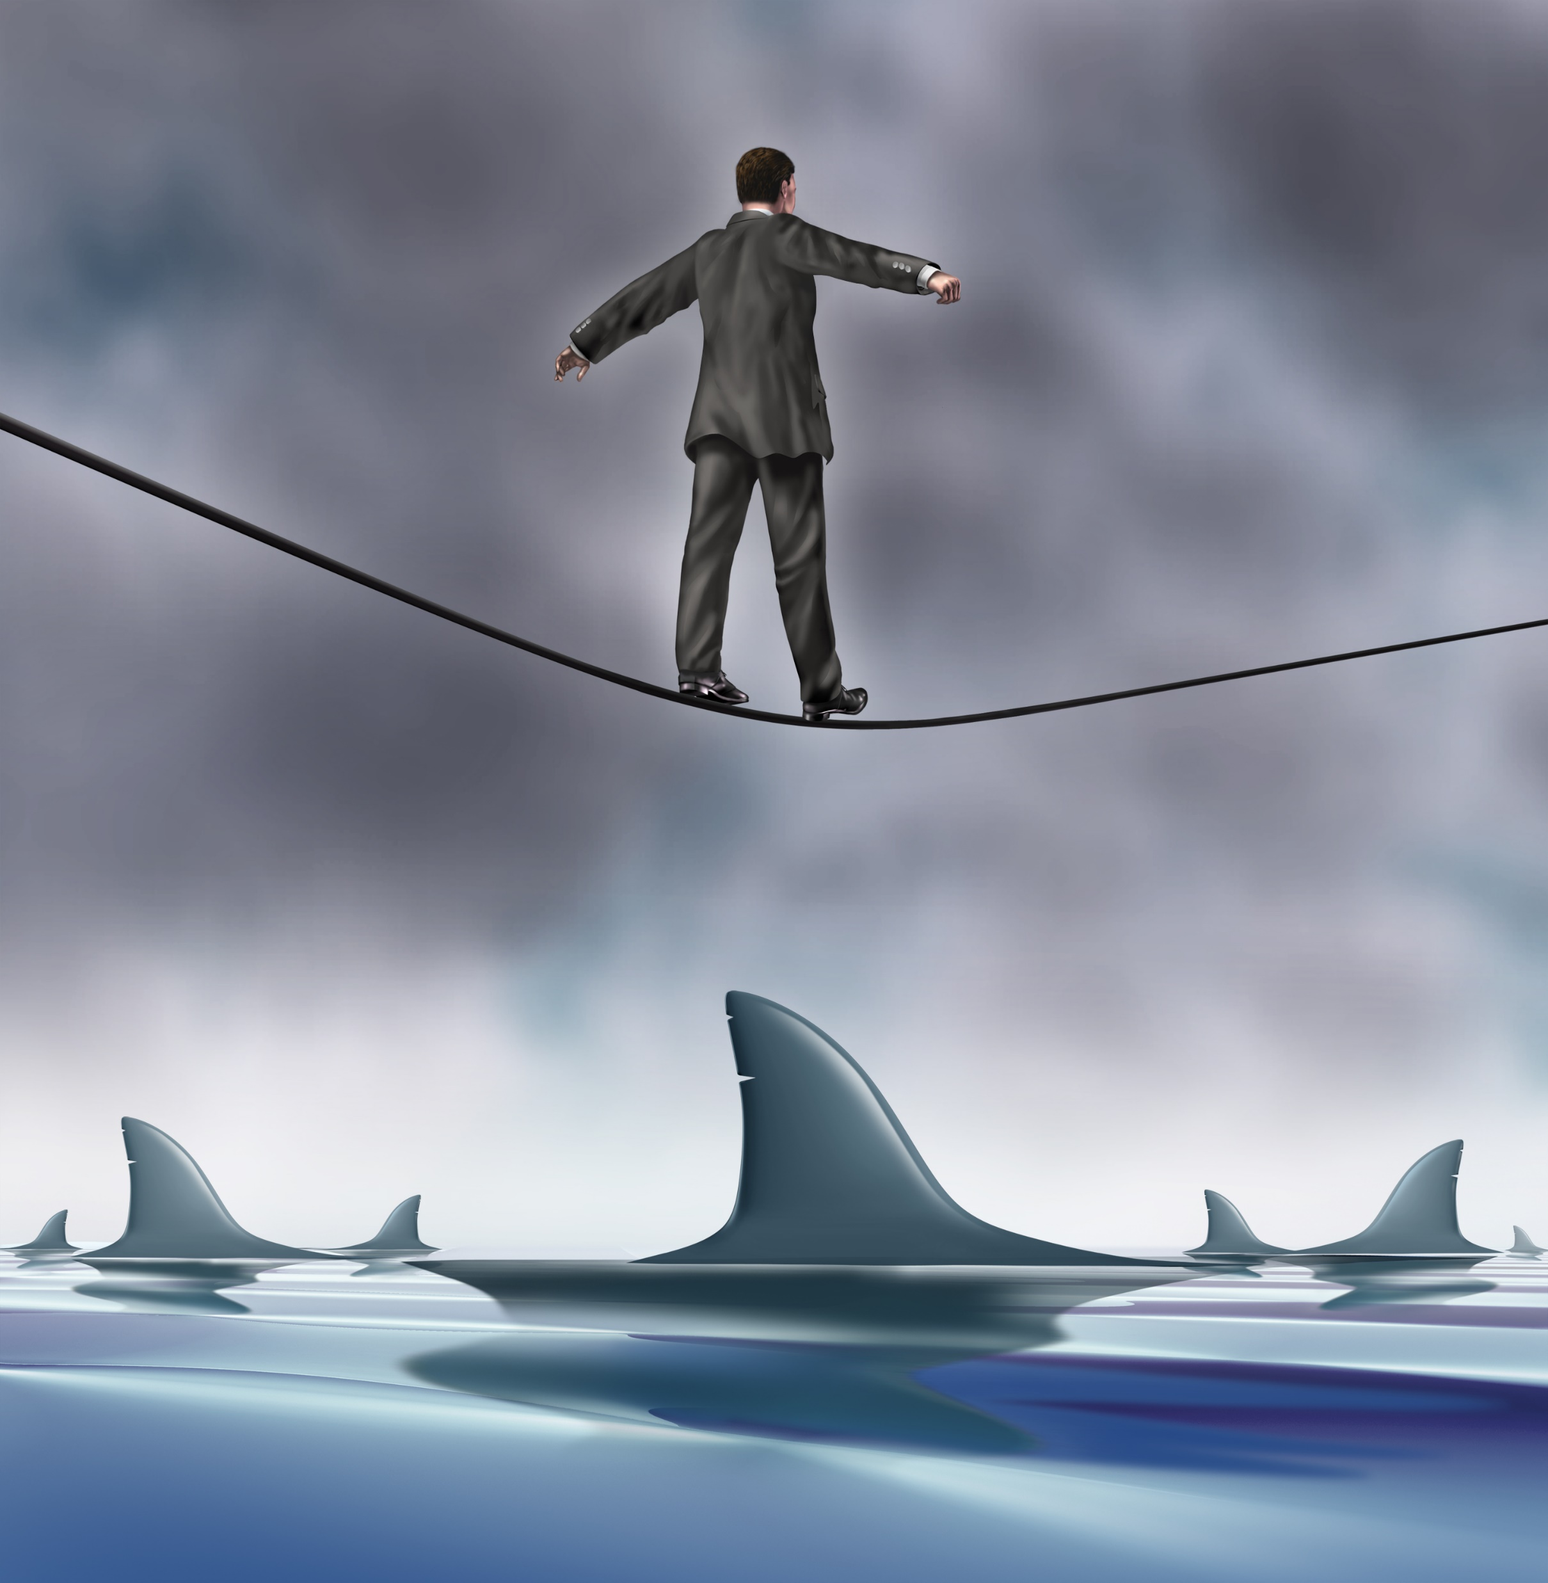
THREATS (External factor --- Uncontrolled)
Threats are factors which have the potential to cause harm to an organization --- Such as, new players in the market, sudden dissolution of a supplier, new technology or regulation and etc.

Slide 24
SWOT ANALYSIS
ABC SOUPS
ABC Soups, which produces ready-to-eat soup mix — The CEO is worried the company is recording good profits at the moment --- But --- He fears that a couple of issues may affect its sustainability before long.
He wants to evolve strategies to manage these issues, and calls a meeting of his managers and team leaders --- He even invites others, including lower-level employees and dealers, to the meeting — He knows almost anyone involved with the company can contribute.

Slide 25
At the meeting, the first thing to do is to identify ABC Soups’ strengths, weaknesses, opportunities, and threats (SWOTs), and then take up a SWOT analysis.
Most of the managers at the meeting are business-school graduates and know what “SWOT” is --- but he explains the concept for the benefit of the other participants.

Slide 26
HOW TO IDENTIFY SWOTs
The CEO explains that a SWOT analysis is a tool for strategy development — In conducting the analysis, a business organization places itself in a conceptual environment where there are both opportunities and threats --- It then identifies its inherent strengths and weaknesses.
Then plans how to make the best use of the opportunities available and minimize the threats.
It also help us how the organization use their strength to capture opportunities and to limit its weaknesses and to avoid threats. These steps together make up its strategies.

Slide 27
The CEO draws a “plus” sign on a display board to make four grids, and labels each of them as “Strengths”, “Weaknesses”, “Opportunities”, and “Threats” (SWOTs), respectively.
He invites the participants to identify the company’s SWOTs, reminding them that they should only use precise information drawn from the company documents for the analysis. The participants come up one by one and wrote the company’s “Strengths”, “Weaknesses”, “Opportunities”, and “Threats” in four grids draws by CEO --- Then common points of all participants used for analysis.

Slide 28
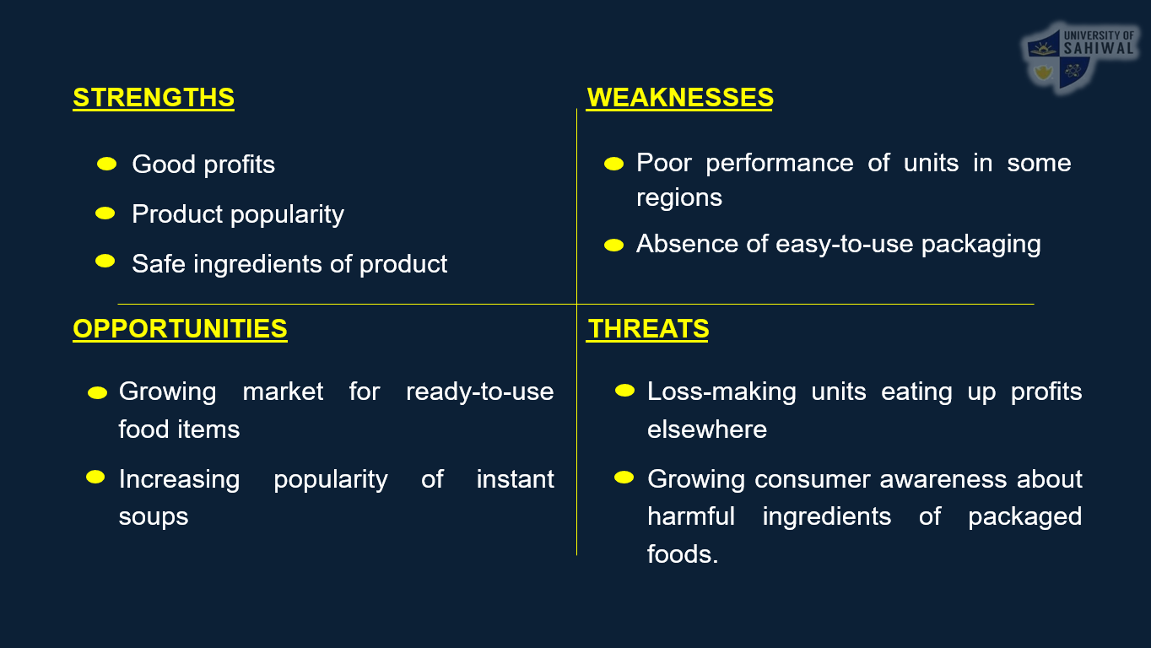
STRENGTHS WEAKNESSES
OPPORTUNITIES THREATS
Good profits
Product popularity
Safe ingredients of product
Poor performance of units in some regions
Absence of easy-to-use packaging
Growing market for ready-to-use food items
Increasing popularity of instant soups
Loss-making units eating up profits elsewhere
Growing consumer awareness about harmful ingredients of packaged foods.

Slide 29
USING SWOT ANALYSIS TO EVOLVE BUSINESS STRATEGIES
ABC’s SOUPS
With the help of the SWOT analysis, the CEO, managers and the others at the meeting evolve strategies for maintaining the company’s profits and ensuring its sustainability.

Slide 30
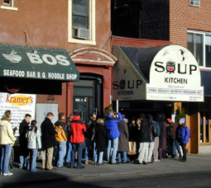
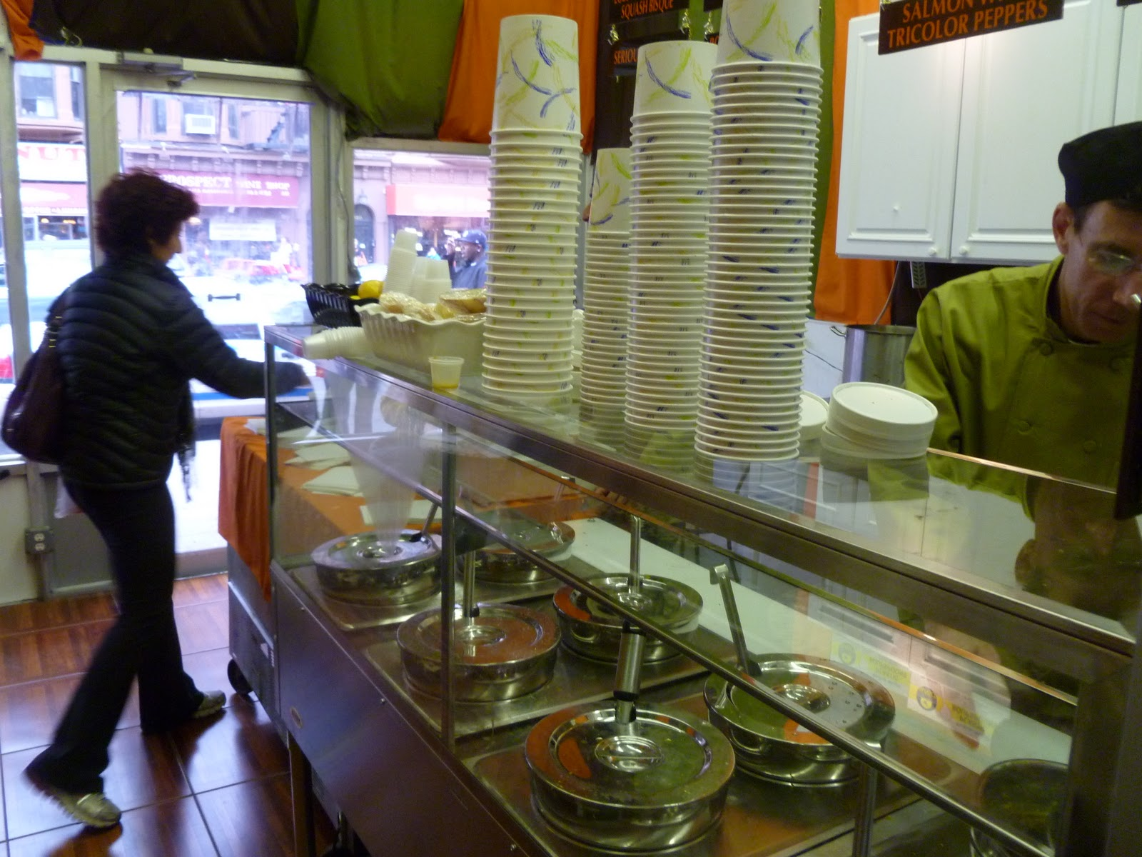
STRATEGY#1
Matching strengths (availability of funds and product popularity) with opportunity (increasing market for instant foods including soups), the participants identify opening more soups branches as a strategy.

Slide 31

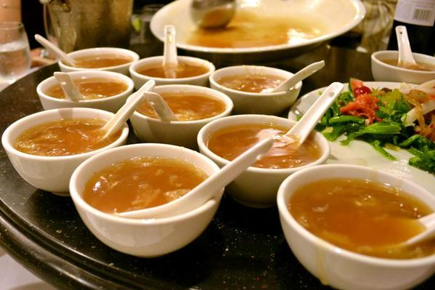
STRATEGY#2
Matching strength (safe ingredients of product) with threat (growing awareness about food safety), they decide upon a strategy of launching a high-profile awareness campaign about the safe ingredients of ABC’s soups. (Protect its self from consumer awareness about harmful ingredients)

Slide 32


STRATEGY#3
Placing weakness (inadequate packaging) and opportunity (growing market) side by side, the management see that it would be a good idea to sell the soup mix in a microwaveable container in which the consumer can cook soup directly.

Slide 33
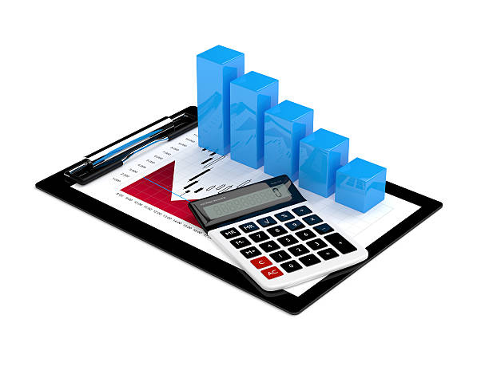
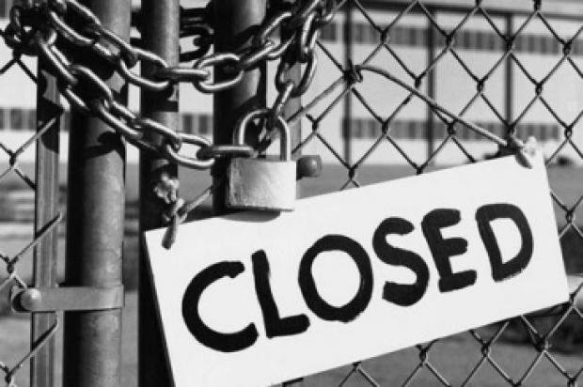
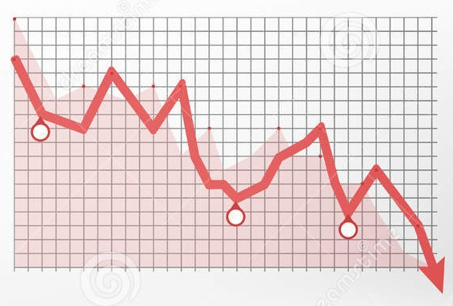
STRATEGY#4
Comparing weakness (poor performance by some units) and threat (impact of loss-making units eating up profits), they feel some of the loss-making units in some regions would have to be closed down.

Slide 34
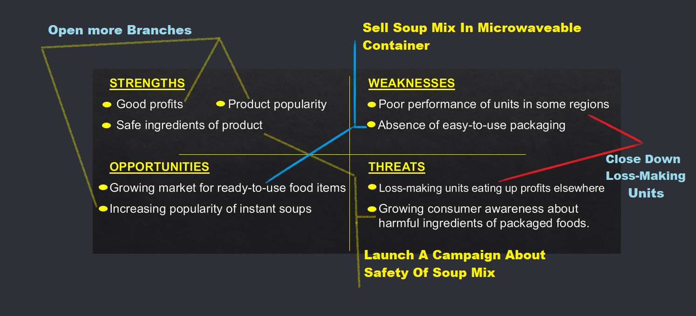

Slide 35
WHEN TO USE SWOT ANALYSIS
A SWOT analysis can be used at any stage in the life of a company --- Usually, It can be used at the start when it is being launched --- or --- Later when it is implementing a new plan or reviewing plans mid-course --- Of course, the analysis can also help find solutions to crises at any time.
TIPS FOR SWOT ANALYSIS
Managers and project leaders are “natural” participants at a SWOT meeting. However, a dealer or even a consumer volunteer can offer usable perspectives.

Slide 36
A SWOT meeting is best held in a relaxed atmosphere, where participants can express their views frankly. It would be a good idea to allocate adequate time — a few hours, rather than a few minutes — to brainstorming.
To identify strengths and weaknesses, only facts and confirmed data should be used, instead of opinions --- Weakness or threats may hide an opportunity --- Conversely, an opportunity easily identified can turn out to be a threat --- If competitors have also identified the same opportunity.

Slide 37
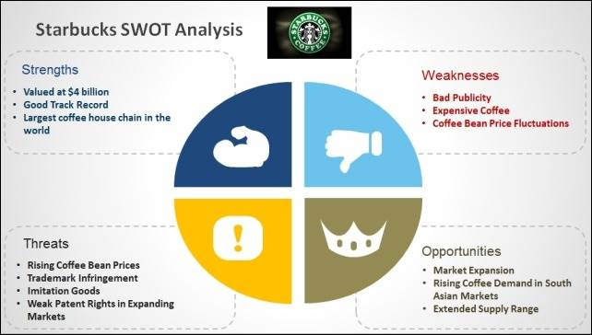

Slide 38
SWOT ANALYSIS TEMPLATE
Here are some questions to ask in order to get a better idea of your company’s strengths, weaknesses, opportunities and threats.
Add other questions that may be relevant for your business and industry to create a SWOT analysis template that fits your corporate strategy.
Strengths and weakness cover internal factors such as human resources, funds, infrastructure, and even past experiences, both good and bad.
Opportunities and threats relate to external factors such as changing consumer trends, economic and political factors, and laws.

Slide 39
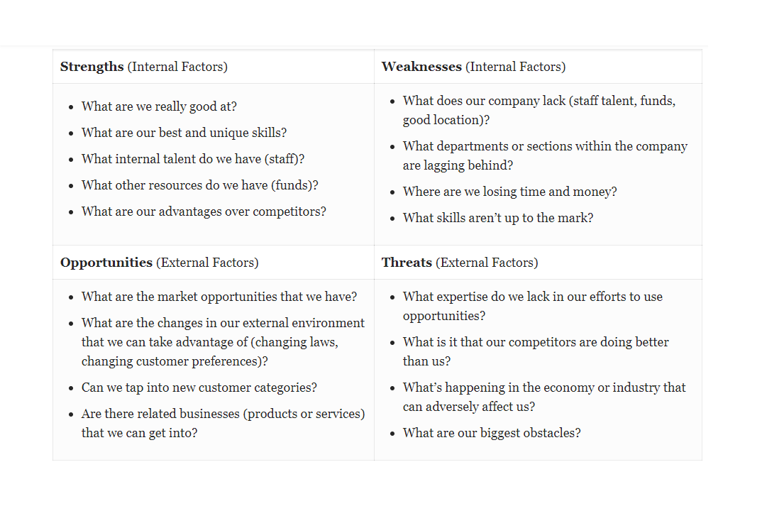

Slide 40
STEP 5: IMPLEMENTING STRATEGIES
Once strategies are formulated, they must be implemented --- No matter how effectively an organization has planned its strategies --- Performance will suffer if the strategies aren’t implemented properly.
STEP 6: EVALUATING RESULTS
How effective the strategies at helping the organization reach its goals?
What adjustments are necessary?

Slide 41
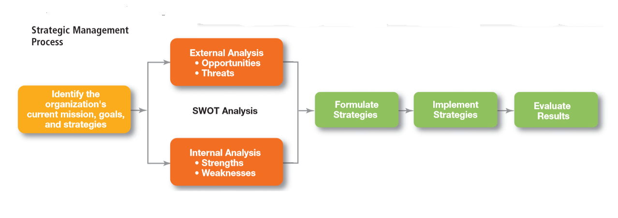

Slide 42

ANY QUESTION
You can contact me at: asadali@uosahiwal.edu.pk
Your query will be answered within one working day.

